Slide 1
Section 1.5 Quadratic Models

Slide 2
Quadratic Models
The graph of a quadratic model always results in a parabola. The general form of a quadratic function is given in the following definition.
A quadratic function is a function where the graph is a parabola and the equation is of the form: where
$y=ax^{2}+bx+c$
The x-coordinate of vertex is given by the equation:
$$x=−\frac{b}{2a}$$

Slide 3
Graph of a Quadratic Model
The direction of the parabola opens can be determined by the sign of the “$x^{2}$ ” term or the term in the above equation. If $a<0$ , then the parabola open downward. Similarly if $a>0$, then the parabola opens upward. (See graphs below)
Graph if $a<0$Graph if $a>0$

Slide 4
Example 1
Find the vertex and x-intercepts of the quadratic equation, and then make a sketch of the parabola. $y=x^{2}−4$

Slide 5
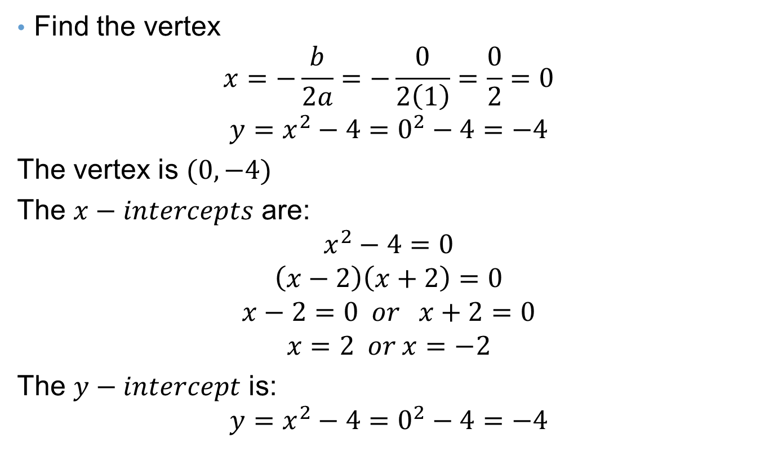
Solution to Example 1
Find the vertex
$$x=−\frac{b}{2a}=−\frac{0}{2\left(1\right)}=\frac{0}{2}=0$$
$$y=x^{2}−4=0^{2}−4=−4$$
The vertex is $(0,−4)$
The $x−intercepts$ are:
$$x^{2}−4=0$$
$$\left(x−2\right)\left(x+2\right)=0$$
$$x−2=0 or x+2=0$$
$$x=2 or x=−2$$
The $y−intercept$ is:
$$y=x^{2}−4=0^{2}−4=−4$$

Slide 6
Solution to Example 1
To sketch the parabola plot the vertex: $(0,−4)$ and the intercepts $\left(−2,0\right);\left(2,0\right), and (0,−4)$

Slide 7
Example 2
Find the vertex and x-intercepts of the quadratic equation, and then make a sketch of the parabola. $y=x^{2}−2x$

Slide 8
Solution to Example 2
Find the vertex
$$x=−\frac{−2}{2(1)}=\frac{2}{2}=1$$
$$y=x^{2}−2x=1^{2}−2(1)=−1$$
The vertex is $(1,−1)$
The $x−intercepts$ are:
$$x^{2}−2x=0$$
$$x\left(x−2\right)=0$$
$$x=0 or x−2=0$$
$$x=0 or x=2$$
The $y−intercept$ is:
$$y=0^{2}−2(0)=0$$

Slide 9
Solution to Example 2
To sketch the parabola plot the vertex: $(1,−1)$ and the intercepts $\left(0,0\right) and \left(2,0\right)$
(1,-1)

Slide 10
Example 3
Find the vertex and x-intercepts of the quadratic equation, and then make a sketch of the parabola. $y=x^{2}−25$

Slide 11
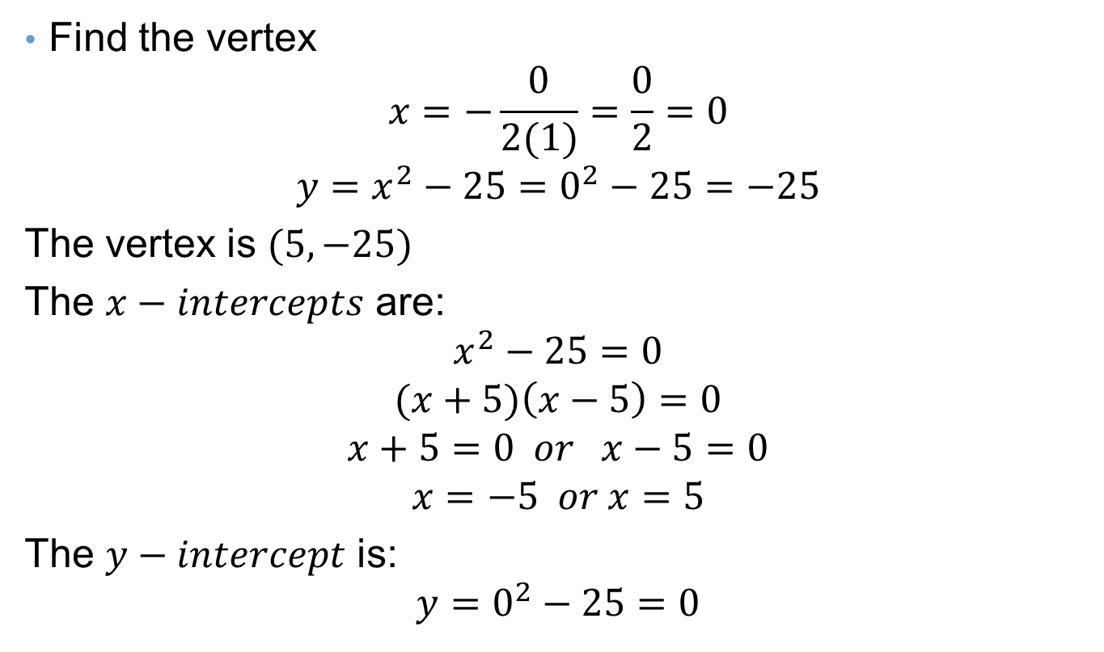
Solution to Example 3
Find the vertex
$$x=−\frac{0}{2(1)}=\frac{0}{2}=0$$
$$y=x^{2}−25=0^{2}−25=−25$$
The vertex is $(5,−25)$
The $x−intercepts$ are:
$$x^{2}−25=0$$
$$(x+5)\left(x−5\right)=0$$
$$x+5=0 or x−5=0$$
$$x=−5 or x=5$$
The $y−intercept$ is:
$$y=0^{2}−25=0$$
(0,-25)

Slide 12
Solution to Example 3
To sketch the parabola plot the vertex: $(0,−25)$ and the intercepts $\left(5,0\right) and \left(−5,0\right)$

Slide 13
Example 4
Find the vertex and x-intercepts of the quadratic equation, and then make a sketch of the parabola. $y=x^{2}−4x+3$

Slide 14
Solution to Example 4
Find the vertex
$$x=−\frac{−4}{2(1)}=\frac{4}{2}=2$$
$$y=x^{2}−4x+3=2^{2}−4\left(2\right)+3=4−8+3=−1$$
The vertex is $(2,−1)$
The $x−intercepts$ are:
$$x^{2}−4x+3=0$$
$$(x−1)\left(x−3\right)=0$$
$$x−1=0 or x−3=0$$
$$x=1 or x=3$$
The $y−intercept$ is:
$$y=0^{2}−4\left(0\right)+3=3$$

Slide 15
Solution to Example 4
To sketch the parabola plot the vertex: $(2,−1)$ and the intercepts $\left(1,0\right) ,\left(0,3\right) and \left(3,0\right)$

Slide 16
Example 5
Find the vertex and x-intercepts of the quadratic equation, and then make a sketch of the parabola. $y=x^{2}+6x$

Slide 17
Solution to Example 5
Find the vertex
$$x=−\frac{6}{2\left(1\right)}=−\frac{6}{2}=−3$$
$$y={(−3)}^{2}+6\left(−3\right)=9−18=−9$$
The vertex is $(−3,−9)$
The $x−intercepts$ are:
$$x^{2}+6x=0$$
$$x\left(x+6\right)=0$$
$$x=0 or x+6=0$$
$$x=0 or x=−6$$
The $y−intercept$ is:
$$y=0^{2}+6\left(0\right)=0$$

Slide 18
Solution to Example 6
To sketch the parabola plot the vertex: $(−3,−9)$ and the intercepts $\left(0,0\right) and \left(−6,0\right)$
(-6,0)
(0,0)

Slide 19
Example 7
The path of a ball thrown by a boy is given by the equation $y=−.04x^{2}+1.5x$ where x is the horizontal distance the ball travels and y is the height of the ball and both of them are measured in feet. Find the maximum height of the ball in feet.

Slide 20
Solution to Example 7
Find the vertex of the parabola.
$$x=−\frac{b}{2a}=−\frac{1.5}{4\left(−.04\right)}=\frac{1.5}{.08}=18.75$$
Find the y-coordinate of the vertex:
$$y=−.04{\left(18.75\right)}^{2}+1.5\left(18.75\right)=−14.06+28.12=14.06 ft$$
2(- 0.04)

Slide 21
Example 8
The path of a cannon ball is given by the equation
$y=−.1x^{2}+6.0x$ where x is the horizontal distance the ball travels and y is the height of the cannon ball. Find the maximum height of the cannon ball in feet.

Slide 22
Solution to Example 8
Find the vertex of the parabola.
$$x=−\frac{b}{2a}=−\frac{6.0}{2\left(−.1\right)}=\frac{6}{.2}=30$$
Find the y-coordinate of the vertex:
$$y=−.1{\left(30\right)}^{2}+6.0\left(30\right)=−.1\left(900\right)+180$$
$$=−90+180=90 ft$$

Slide 23
Example 9
The path of a cannon ball is given by the equation $y=−.2x^{2}+3.0x$ where x is the horizontal distance the ball travels and y is the height of the cannon ball. Find the maximum height of the cannon ball in feet.

Slide 24
Solution to Example 9
Find the vertex of the parabola.
$$x=−\frac{b}{2a}=−\frac{3.0}{2\left(−.2\right)}=\frac{3}{.4}=7.5$$
Find the y-coordinate of the vertex:
$$y=−.2{\left(7.5\right)}^{2}+3.0\left(7.5\right)=−11.25+22.5=11.25 ft$$

